Slide 1



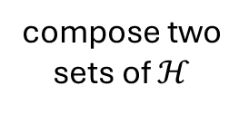
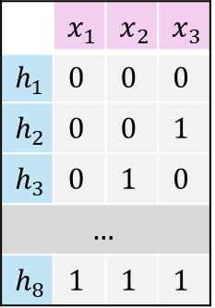




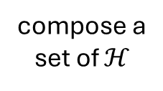

















a composed hypothesis class $ℋ$
hypothesis universe $ℋ^{uni}$
$$h_{1}$$
$$h_{3}$$
used for training
$$ℋ^{ID}$$
$$h_{7}$$
$$h_{8}$$
 | $$x_{1}$$ | $$x_{2}$$ | $$x_{3}$$
$$h_{1}$$ | $$0$$ | $$0$$ | $$0$$
$$h_{2}$$ | $$0$$ | $$0$$ | $$1$$
$$h_{3}$$ | $$0$$ | $$1$$ | $$0$$
$$…$$
$$h_{8}$$ | $$1$$ | $$1$$ | $$1$$
$$h_{1}$$
$$h_{3}$$
compose two sets of $ℋ$
$$h_{7}$$
$$h_{8}$$
$$h_{1}$$
$$h_{3}$$
used for testing
ID hypothesis class generalization
split
$$h_{7}$$
$$h_{8}$$
$$ℋ^{OOD}$$
compose a
set of $ℋ$
$$h_{2}$$
$$h_{4}$$
$$h_{2}$$
$$h_{4}$$
used for testing
OOD hypothesis class generalization
$$h_{5}$$
$$h_{6}$$
$$h_{5}$$
$$h_{6}$$

